Slide 1
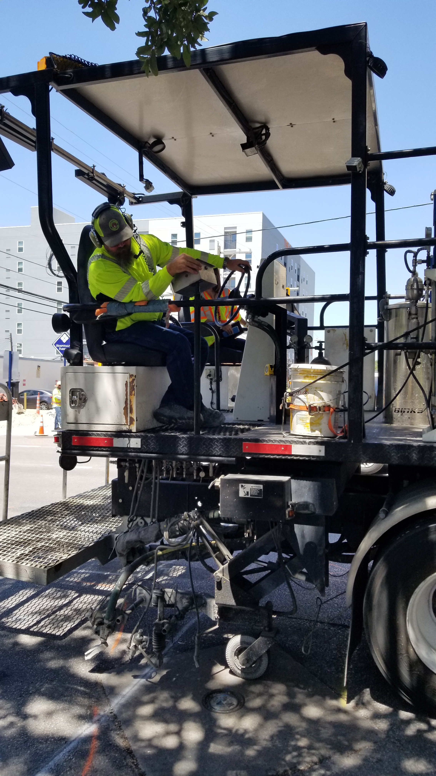
G:\ATD\Signs_and_Markings\MISC_PROJECTS\Photos_TechRoom_TV\20190725_123110.jpg

Slide 2
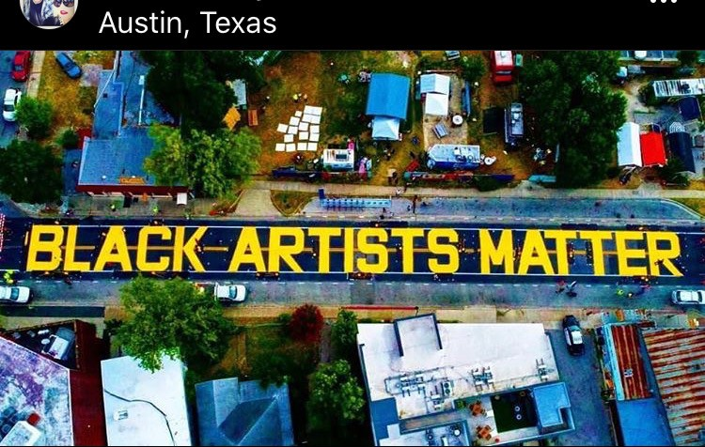
G:\ATD\Signs_and_Markings\MISC_PROJECTS\Photos_TechRoom_TV\Black Artists Matter_E 11th St_Waller to Lydia_Aerial View_061820.jpg

Slide 3
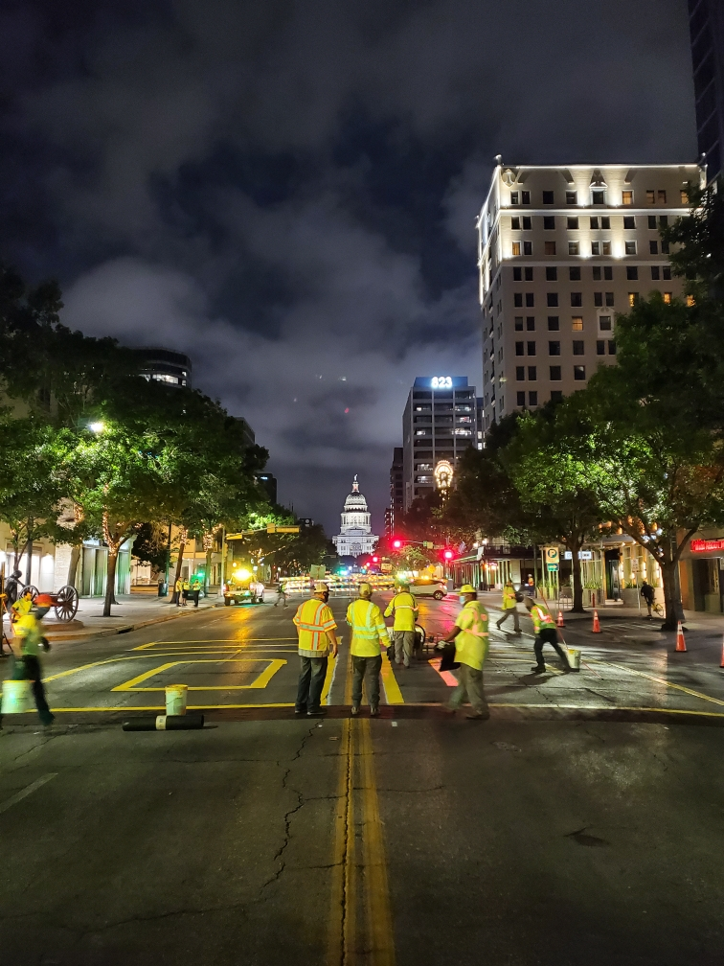
G:\ATD\Signs_and_Markings\MISC_PROJECTS\Photos_TechRoom_TV\Black Austin Matters_Congress Ave_061620.jpg

Slide 4
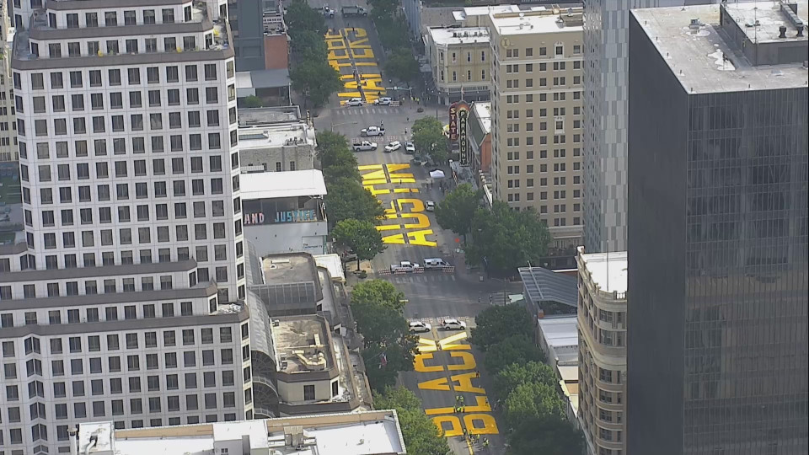
G:\ATD\Signs_and_Markings\MISC_PROJECTS\Photos_TechRoom_TV\Black Austin Matters_Congress Ave_Aerial View_061620.jpg

Slide 6
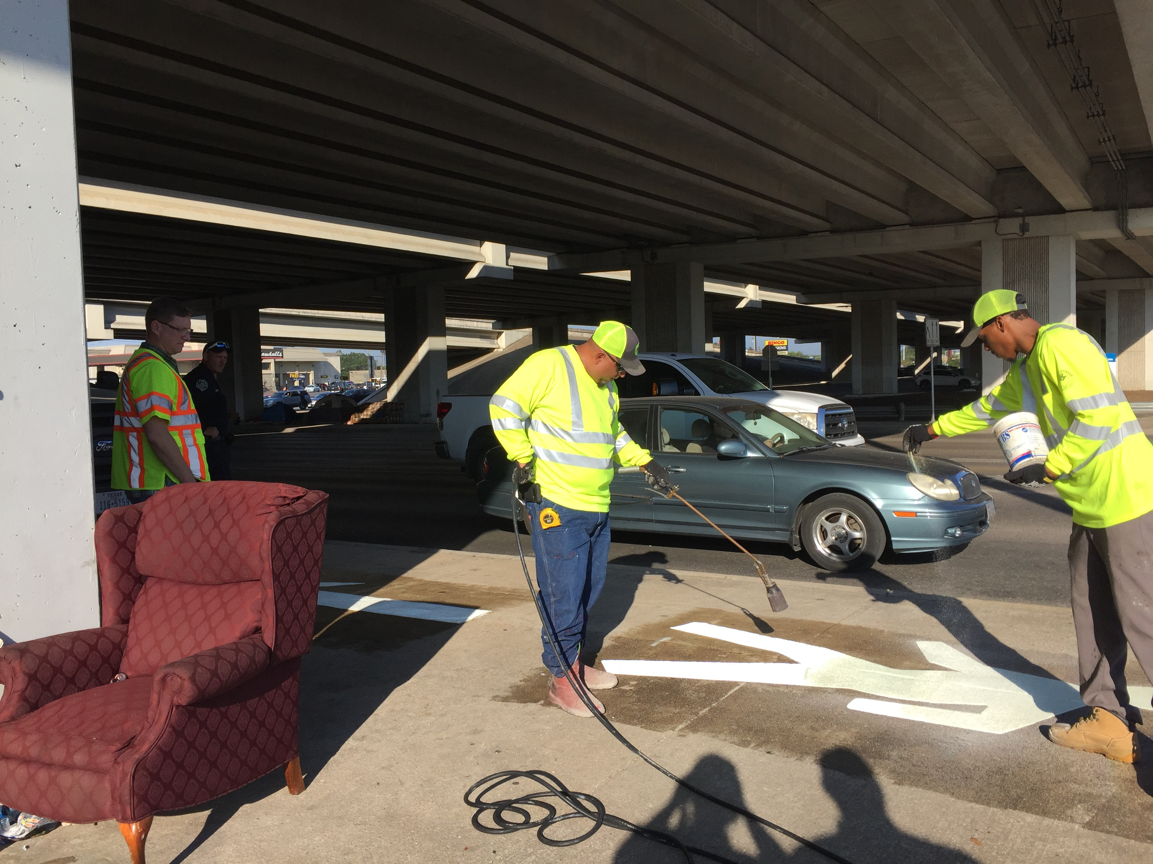
G:\ATD\Signs_and_Markings\MISC_PROJECTS\Photos_TechRoom_TV\IMG_1507.JPG

Slide 10
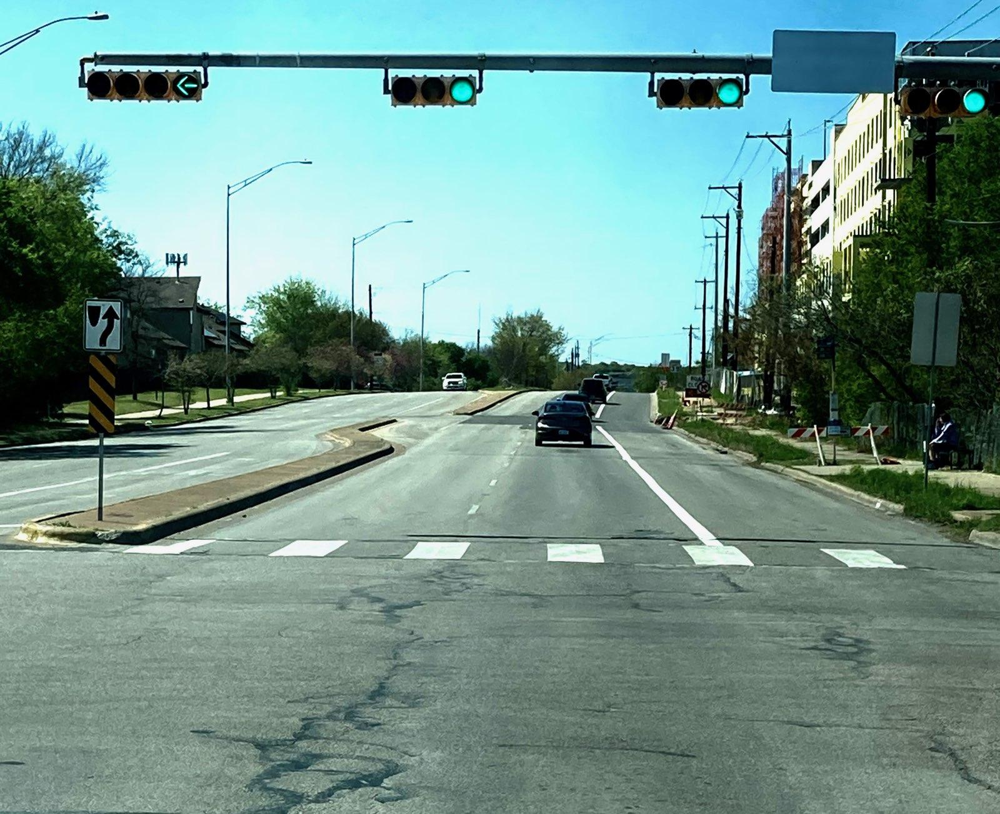
G:\ATD\Signs_and_Markings\MISC_PROJECTS\Photos_TechRoom_TV\Riverside Bus Lane EB 1_032521.JPG

Slide 11
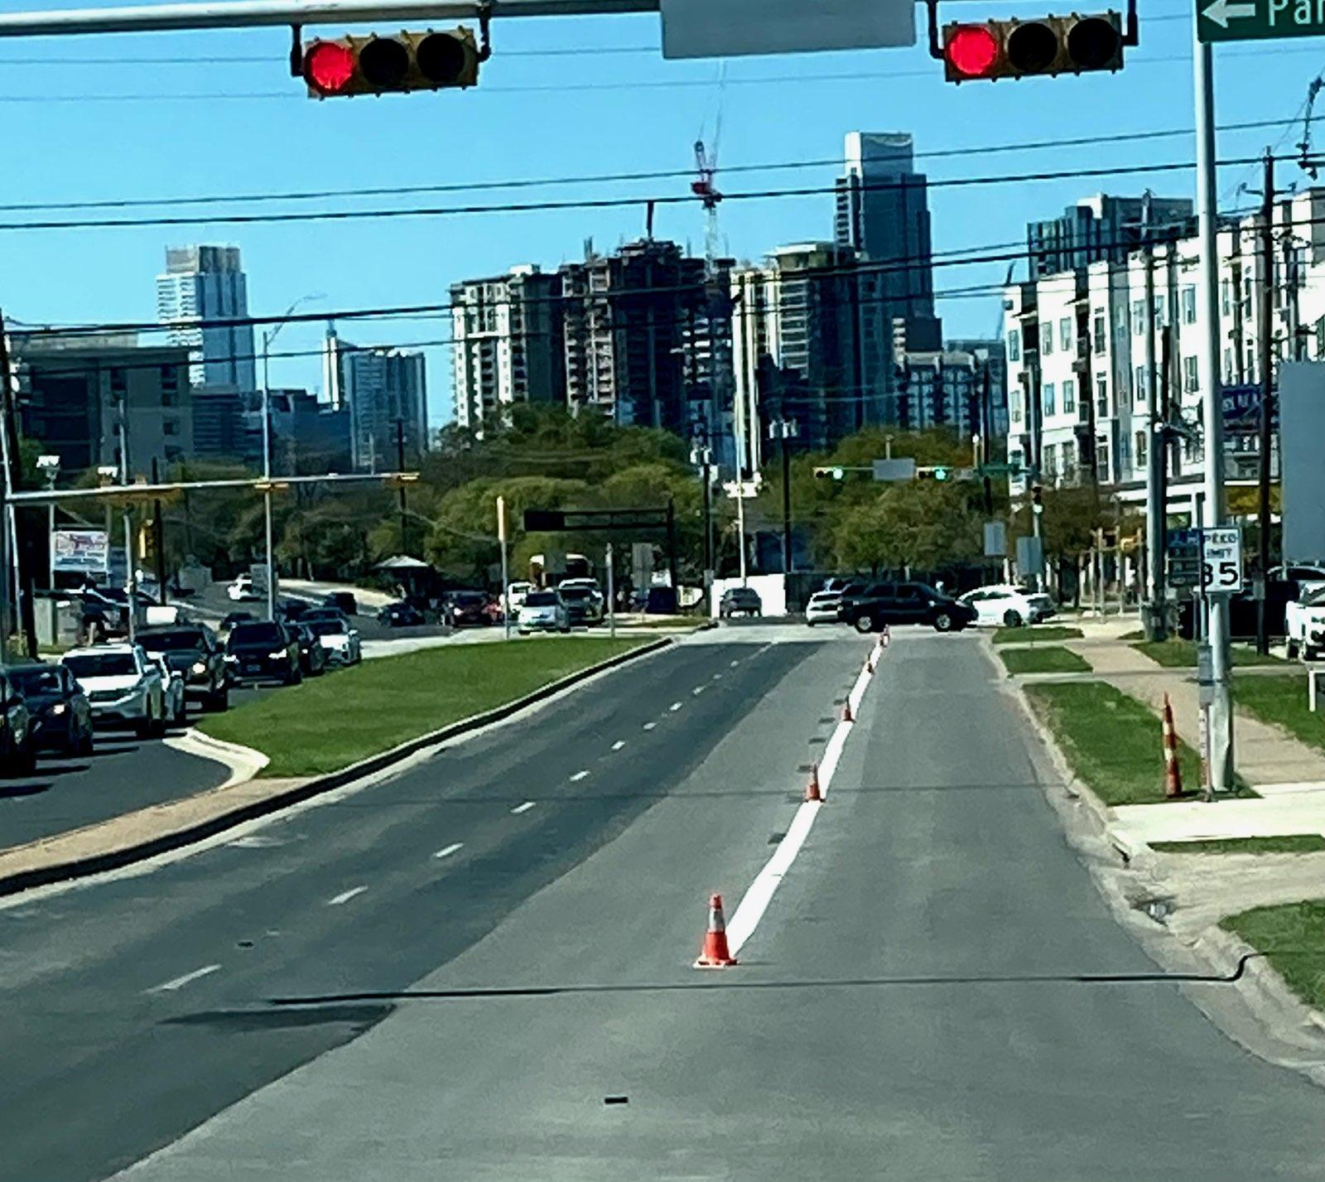
G:\ATD\Signs_and_Markings\MISC_PROJECTS\Photos_TechRoom_TV\Riverside Bus Lane EB 2_032521.JPG

